Slide 1
Seizure First Aid

Slide 2
Who? What?
1 in 10 people will have a seizure during their lifetime. About 10% of people.
In the United States, 3.4 million people live with Epilepsy
Anyone, anywhere , can have a seizure
A seizure is uncontrolled jerking, loss of consciousness, blank stares, or other symptoms caused by abnormal electrical activity in the brain

Slide 3
What causes a seizure?

Slide 4
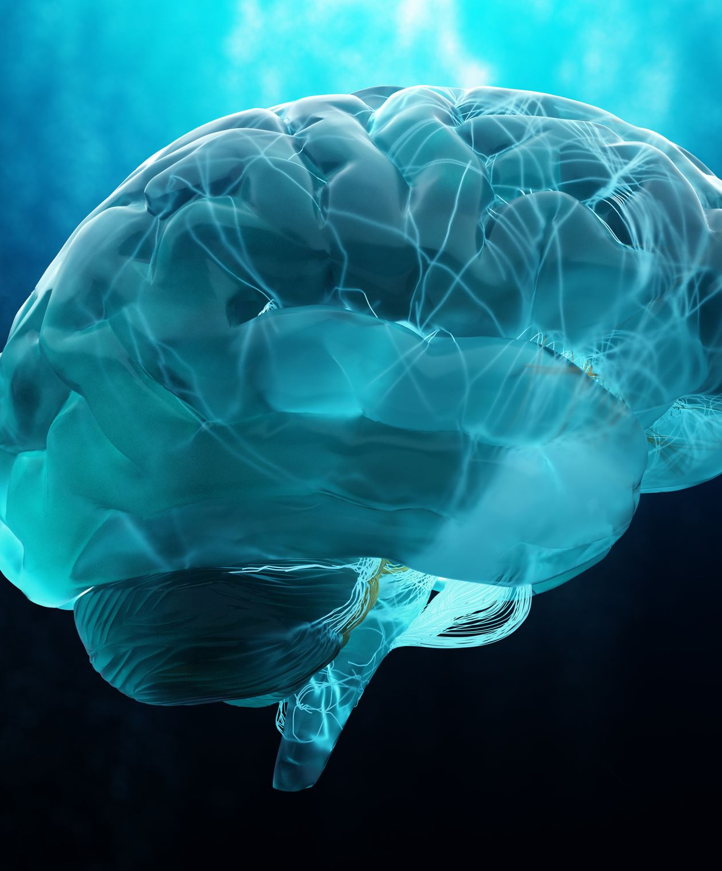
Types of Seizures
Generalized seizures (generalized onset seizures): Electrical activity starts on both sides of your brain at the same time. You may shake both sides of your body, shake one side or only stare and stop what you’re doing. Usually, it affects kids or young adults, but it can occur at any age.
Absence seizures- they stop what they are doing and have a blank stare
Tonic/Clonic- loss of muscle control, twitching, drop to ground, convulsions
Focal seizures (focal onset seizures): Electrical activity begins on one side or “focus” of your brain. Symptoms usually affect one side of your body and may or may not affect your awareness. This means that you may or may not remember the seizure. Focal seizures may stay focal or may spread to both sides.

Slide 5
Types of seizures:
Provoked seizures (nonepileptic): A trigger, which could be a temporary condition or certain circumstances, causes seizure symptoms to happen.
Unprovoked seizures (epileptic): Seizures happen spontaneously (randomly). They may happen often. These seizures are the primary symptom of epilepsy.
Seizures without a known cause are called idiopathic seizures.

Slide 6
Seizure Triggers:
The following may trigger a seizure:
Abnormal blood sugar levels (low or very high blood sugar).
Medications
Flashing or flickering lights.
Heat illness.
High fever.
Sleep deprivation.
Stress.
Substance use (including alcohol withdrawal).

Slide 7
Conditions that could cause a Seizure:
Tumors/Aneurysms
Diabetes
Concussions/Brain Injury
Alzheimer's/Dementia
Epilepsy
Infections
Strokes
Toxins/Poison
Snake bite

Slide 8
Management/Treatment
Seizure treatment varies based on the type, severity and cause. Your healthcare provider may recommend the following:
Managing any underlying causes or conditions: Your provider will first treat any underlying conditions — like a stroke or low blood sugar. This may prevent future seizures.
Taking antiseizure medications: Medications may help prevent seizures or decrease how often they happen.
Surgery: Surgery may reduce seizure frequency and severity by addressing the area of your brain where seizures start (focal point).
Brain stimulation: A surgeon will implant a device into your brain to deliver a mild electrical current. The current interferes with and tries to stop abnormal electrical activity. There are different types of brain stimulation available, like vagus nerve stimulation.

Slide 9
What to do if you are with someone who is having a seizure:
What to look for during the seizure: Early signs, during the seizure and after a seizure
Prodrome phase: Before a seizure, you may notice mood or behavioral changes, feel lightheaded or have trouble focusing. Days before a seizure, you may have trouble sleeping.
Aura phase: Right before the first symptoms of a seizure start, you may notice vision changes, a headache, dizziness, nausea, anxiety or fear, and changes to your senses (like taste, sound, smell and feeling).
Ictal phase: This is when a seizure happens. You’ll experience seizure symptoms. Start your timer or look at your clock and time how long the seizure lasts
Postictal phase: Immediately after a seizure ends, you may feel confused, exhausted, sore, strong emotions and more.
Not everyone who has a seizure experiences all phases, especially the aura. Many seizures come on suddenly and you’re unaware of any early signs.

Slide 10
FYI about Seizures:
Not usually a medical emergency
Seizures are not contagious
They cannot swallow their tongue when having a seizure
Not every seizure looks the same
It is rare but you can die from a seizure

Slide 11
Seizure First Aid: Stay, Safe, Side
Stay with the person, stay calm, check to see if they have a medical ID bracelet or necklace, Time the seizure
Safe: Keep them safe, move harmful objects out of the way, if they are wandering around keep them away from stairs
Side: Roll them on their side, loosen any tight clothing around the neck, keep the airway clear. DON’T put anything in their mouth. DON’T RESTRAIN

Slide 12
When to call 911
If it is their 1st seizure ever
The seizure is lasting over 5 minutes, or they are having one after the other
The person was in the water or pool
The person is injured
Difficulty breathing
Pregnant or Diabetic
The person does not return to their usual state once the seizure is over

Slide 13
Seizure Video
Seizures & You: Take Charge of the Storm Jr. (Grades K-5)
Febrile/Infant: Febrile Seizure (3D Animation)
Absent Seizure: Example of Absence Seizure
Focal Seizure: Example of Focal Seizure with Impaired Awareness
Tonic seizure: (16598) Example of a Tonic Clonic Seizure - YouTube
Tonic Clonic Seizure - TESS Research Foundation

