Slide 1
Basic First Aid
Be a First Aid Hero!!

Slide 2
What is First Aid?
What do you think first aid means?
When have you seen someone need first aid?
Notes:
Write on board- when to use first aid and what tools might you need. Put student response

Slide 3
Would you rather: Safety Edition
First Aid
1) Clean a scraped knee with soap and water OR bandage a friend finger?
2) Use gauze to stop a nosebleed OR put ice on a swollen ankle?
3) call 911 in an emergency OR run to get an adult for help?
Safety Awareness
1) Always wear a helmet while biking OR always wear kneepads while skateboarding?
2) keep a small first aid kit in your backpack OR know how to do CPR?
Risk vs Responsibility
1)Treat a bee sting OR treat a sprained wrist?
2) Learn how to help someone with Asthma OR someone who fainted?

Slide 4
Wounds- Cuts, Puncture, Scrapes, Abrasion
- If bleeding you need to apply pressure
Clean wound with warm soapy water or antiseptic gel/spray
If cut with rusty object need to check for updated tetanus shot
Watch for signs of infection: Redness, pussy drainage, fever, confusion, swelling, increase in pain
If there is something penetrating or sticking into the person DO NOT PULL IT OUT. Immobilize it with dressing if possible and call for help
Notes:
Have wounds for them to clean and bandage

Slide 5
Sprains and Strains
R- rest affected limb
I- Ice affected limb- 20 minutes on 4-5 times a day for 48 hours
C- Compression- wrap with an elastic bandage
E- Elevate affected limb
Notes:
What can you use for Ice bag or cold compress? Make sure not on skin
Have a limb to practice ace wrap

Slide 6
First Degree Burns
Mild burn affecting the outer layer of skin
Symptoms- Redness, mild pain, dry skin (no blisters)
Examples- Touching a hot metal seatbelt buckle in the summer and your skin turns red and sore for a day
- Mild sunburn after being outside too long without sunscreen
Treatment- Cool the area with cold water, apply aloe vera or burn cream and avoid popping any bubbles

Slide 7
Second degree Burns
Burn affect the outer layer and part of the second layer of skin
Symptoms- Blisters, swelling, red or splotchy skin, more intense pain
Spilling hot soup or boiling water on your hand and it blisters within minutes
Touching a hot curling iron and a blister forms where it touched your skin
Treatment- Cool the area gently with water, DO NOT pop the blisters, cover loosely with a clean bandage

Slide 8
Third Degree Burns
Serious burn that damages all layers of skin and possibly tissue underneath
Symptoms- Skin may look white, black, brown or charred and may even feel numb
Touching a flame or open fire and the skin turns black and leathery
Electrical burns from a wall socket or firecracker
Clothing catches fire and burns through multiple layers of skin
Treatment- This is a medical emergency, Call 911, DO NOT remove stuck clothing or apply ice. Keep the person calm until help arrives

Slide 9
Burn examples
Notes:
Bring out the skin layers

Slide 10
Burn Rhyme
“Red and sore? First for sure
Blisters too? Second degree for you
Numb and charred? Third is hard!

Slide 11
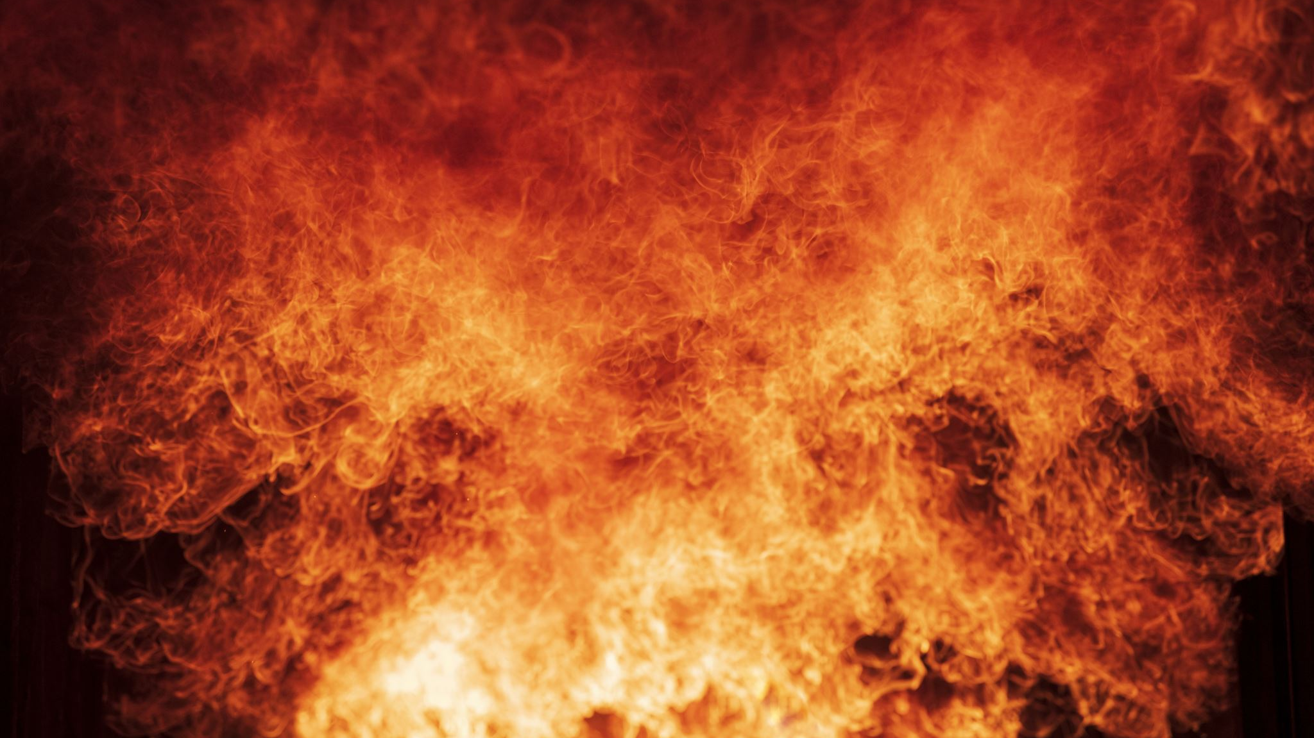
The Elements: Heat/Cold
Heat Exhaustion
Heat Stroke
Frost Bite
Hypothermia

Slide 12
Heat
Heat Exhaustion- Symptoms: Dizziness, weakness, nausea, headache, vomiting, Cool or moist skin or profuse sweating, thirsty, muscle cramps
Treatment: Drink plenty of fluids: Sports drinks, water and move to a cool shaded area
Heat Stroke- More critical- sweating has stopped and body temperature rises rapidly. Person is not aware of thirst or heat, they may be confused, delirious, irrational behavior or they may lose consciousness or have a seizure or convulsion. Skin is red, hot and dry. They may have muscle cramps, dilated pupils, shallow breathing and a rapid but weak pulse
Treatment- Seek medical attention immediately, get to a cool place, try and cool skin with wet rags or cold water: apply to arm pits, neck and groin areas. Elevate their feet and give small but frequent sips of sports drink or water

Slide 13
Cold
Frost Bite- Numbness to suspected area, skin is discolored, waxy looking, pain and cold to the touch.
Treatment- soak in warm water: no warmer that 100-105 degrees until area is red and feels warm. Bandage area with soft cloth and seek medical attention.
Hypothermia- Critical- Decreased level of consciousness, glassy stare, rigid muscles, shivering, slow and irregular pulse, slurred speech
Treatment- Call 911, Have them lie down, remove clothing and cover with warm blankets. Give warm drinks if able( no caffeine or alcohol). DO NOT put them in water

Slide 14
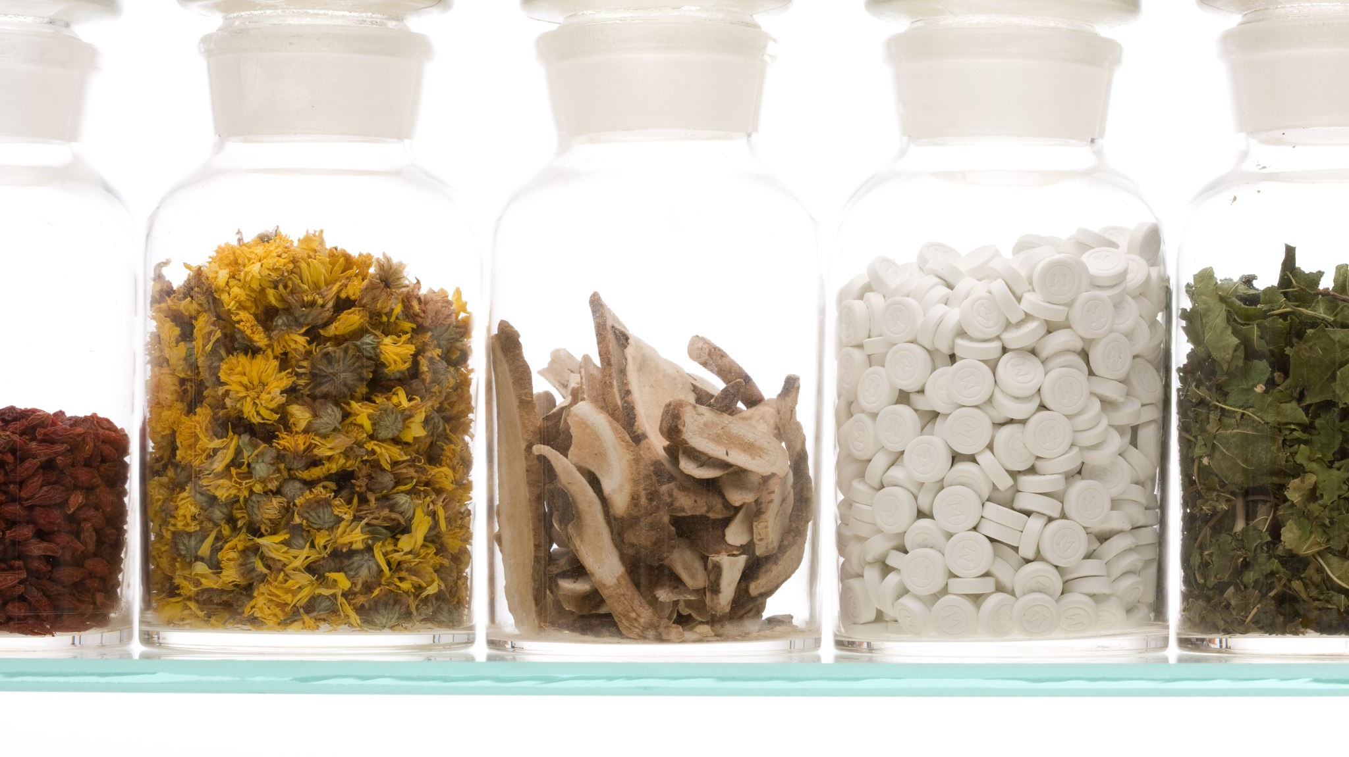
Poisoning
Swallowed- Household chemicals, medications and pesticides
Inhaled-Carbon Monoxide

Slide 15
Poison cont.
Symptoms: Burns on mouth/lips, stains and odor on clothing, nausea/vomiting, trouble breathing or coughing, drooling, stomach pain, sleepy, confusion, dizziness, double vision, weakness, heart palpitations
Treatment: Find source of poison is you can, call Poison control- they may direct you on what to do. If you have Ipecac syrup on hand you may give to have person through up any ingested poison. If they inhaled, it get them to fresh air. May need to call 911 or start CPR.
*Carbon Monoxide is odorless, colorless gas that is potentially dangerous- Symptoms are headache, disorientation, agitation, to unconsciousness and coma.
Common household items to keep out of reach of children: All medications/drugs, Window cleaner, bleach, drain opener, fabric softner, fertilizer, furniture polish, gasoline, laundry/dish detergent

Slide 16
Heart Attack and Stroke- when blood flow to the area is decreased or blocked
Know the Signs of Stroke – Use FAST:
Face Drooping
Arm Weakness
Speech Trouble
Time to Call 911
❤️ Know the Signs of a Heart Attack:
Chest pain or pressure
Trouble breathing
Cold sweat
Nausea or feeling lightheaded
🚨 What to Do in an Emergency:
Stay calm.
Call 911.Give your name, location, and what’s happening. Stay with the person until help arrives.

Slide 17
Keep your Heart and Brain Healthy
✅ Drinking water every day
✅ Getting active (60 minutes a day)
✅ Eating fruits, veggies, and whole grains
✅ Getting enough sleep
✅ Talking to adults when something doesn’t feel right
🩺 Remember: You can be a health hero at any age!
Notes:
After this slide do some role play with the students on what a MI or CVA might look like

Slide 18
Helping someone who is having a stroke #FirstAid #PowerOfKindness
Heart attack - how to help #firstaid #heartattack #shorts

Slide 19
Insects, Snakes and Spider Bites
Bee and Wasp Stings: Red, swollen, painful area with a small point of entry in the center.
Use a credit card or a carboard edge to scrape out the stinger. DO NOT use a tweezers, Wash area with soap and water and then apply ice/cold pack. You can use calamine lotion or mix baking soda and water, or hydrocortisone cream to help with pain and itch
Snake Bites- If you can take a good look at the snake so you can describe it
Symptoms: Sharp pain, swelling, weakness, short of breath, vomiting, dizziness and blurred vision.
Have person lie quietly and keep bite area below the heart. If you can clean the area of bite, wipe away from wound so more venom doesn’t get in the wound. DO NOT cut the bite or try to suck out the venom, DO NOT apply ice
Spider Bites-If you can look at spider for description but better yet bring it with you if possible
A black widow and brown recluse spider need immediate medical attention
What You Need to Know About Spider Bites

Slide 20
CPR and Heimlich (chocking)
Basics of CPR from the Red Cross
How to Give the Heimlich Maneuver | First Aid Training

