Slide 1

Vital Signs
By Beth Neyen MSN, RN, CMSRN, CHSE

Slide 2
Why do nurses check these, what do they tell us?
Vital Sign | What It Measures | Normal Range (Kids/Teens)
Blood Pressure | Force of blood in arteries | ~100–120/60–80 mmHg
Heart Rate | Beats per minute | 60–100 bpm
Respiratory Rate | Breaths per minute | 12–20 breaths/min
Temperature | Body heat | 97–99°F (36.1–37.2°C)
Pulse Oximetry | Oxygen in blood | 95–100%

Slide 3
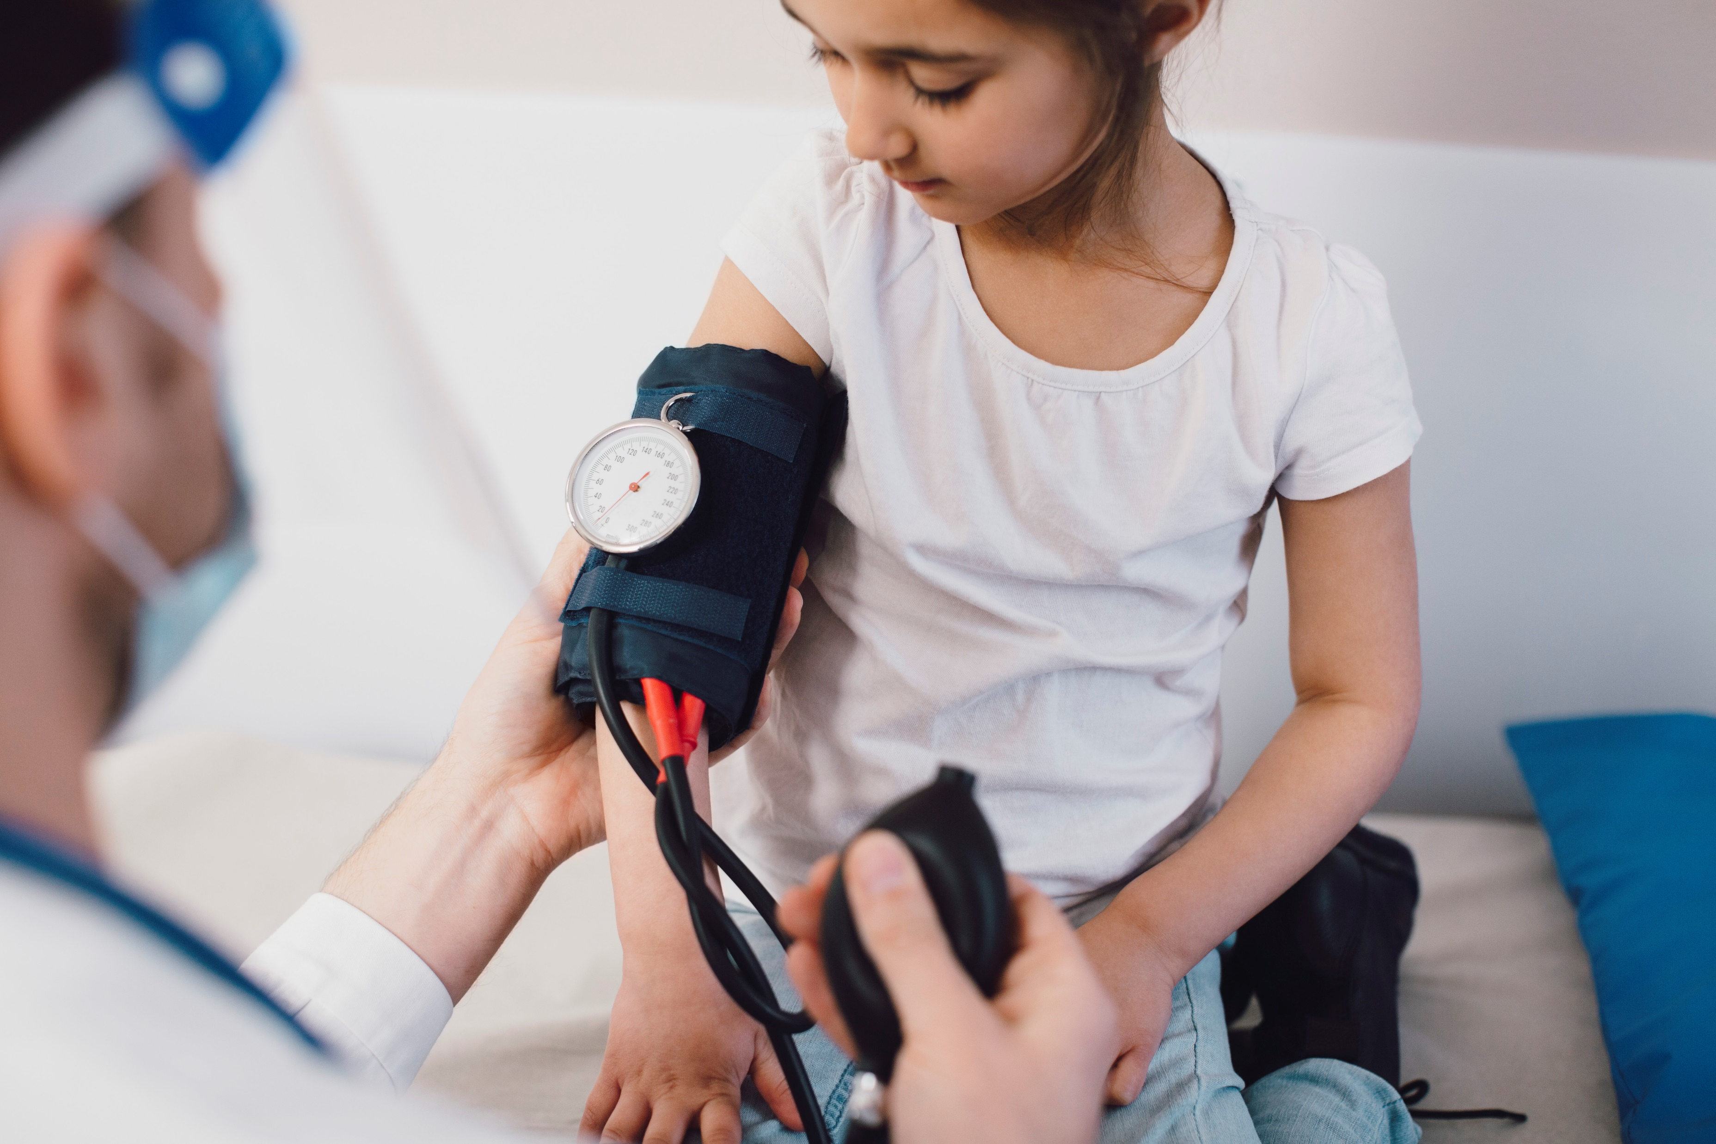
Blood Pressure

Slide 4
Equipment
Stethoscope
Ear tips(earpieces)
Ear Tubes-angle to fit ear properly
Tubing
Chest piece- Bell- use for listening to low pitched sounds, Diaphragm- use for high pitch sound
Sphygmomanometer
BP cuff
Tubing- One connects to inflation bulb and one to the pressure-monitoring device
Inflation bulb
Pressure monitoring device- (manometer)

Slide 5
Blood pressure is the force that blood exerts against the vessel wall. We listen for the sound or beat. When we first hear it, this is the top number of the blood pressure or the Systole. When we last hear the beat, this is the bottom number or Diastole.
Normal range for BP is 90-120/60-80
Let's Practice ☺

Slide 6

Heart Rate
Auscultate- use stethoscope to listen to the heartbeat. Normal sound is S1 and S2 (lub/dub)
Palpate- use your fingers to push and find the heartbeat.
  Radial- wrist
  Carotid- neck
Normal heart rate is 60-100 beats per minute
Let's Practice ☺

Slide 7
Respirations
Two phases of breathing
  Inspiration
  Expiration
  Assess the rate, depth and rhythm of respirations
  Normal range for respirations is 12-20 breaths per minute
  You need to count the in/out as 1 breath
  Let's practice ☺

Slide 8
Temperature
Measurement of body temperature. Because surface temperature varies the best place to take temperature varies on age and situation.
Types of Thermometers: Electronic, Tympanic, Temporal, Chemical Dot, Rectal
Temperature is affected by age, exercise, hormones, stress, environment, time of day, body site used and medications.
Normal range is considered 36-38 degrees Celsius or 96.8-100.4 degrees Fahrenheit

Slide 9
Pulse Oximetry
A noninvasive way to measure the oxygen saturation. It works by reading the light reflected from your hemoglobin molecules that are saturated with oxygen. The expected range for healthy people is 95-100%.
To get the best reading attach the sensor to fingers, toes, earlobes, the bridge of the nose.

Slide 10
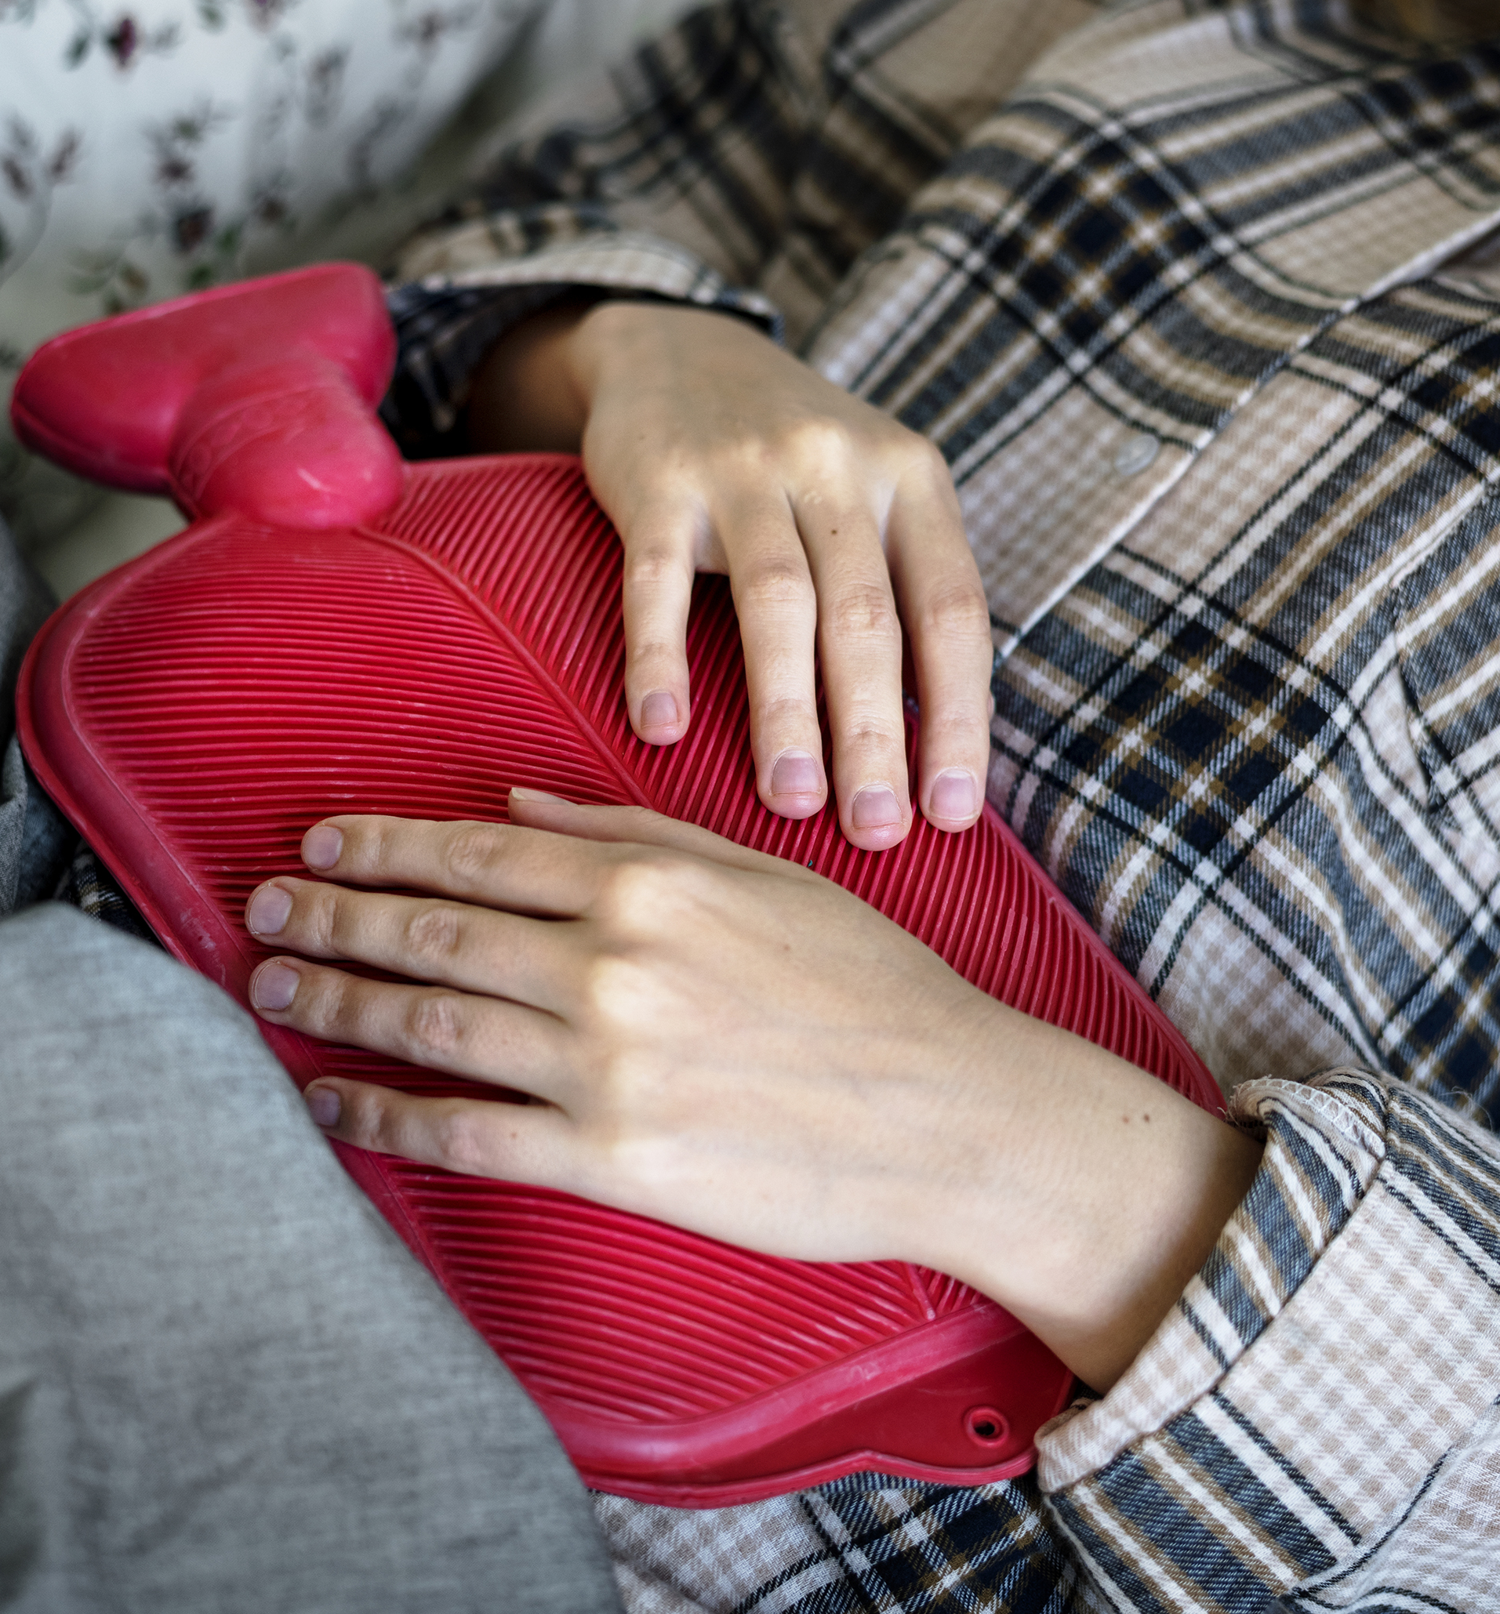
Pain
Often considered the 5th vital sign. Pain can affect your physical, emotional and mental well being.
We need to manage pain as quickly as possible so they can do their activities of daily living
Tools we use- Numeric, Cries, Faces, Oucher

