Slide 1
Understanding Diabetes What is it and how to stay health by Beth Neyen msn, rn, cmsrn, chse

Slide 2
What is diabetes
Diabetes is a health condition where the body has trouble using sugar (glucose) for energy. Glucose comes from the food we eat, especially things like bread, rice, and sweets

Slide 3
How does the body normally work

Slide 4
When you eat, your body breaks food into glucose. The pancreas makes insulin, a hormone that helps glucose enter your cells..
Insulin helps move glucose from the blood and into your cells for energy. Insulin will lower your blood sugar.
Insulin is a medication as well: This medication is very expensive and must be cared for properly. Make sure unused vials are kept in fridge. You may keep the vial at room temperature for 28 days.

Slide 5
Types of Diabetes and what happens
Type 1 Diabetic: Usually starts in kids and teens/young adults. The pancreas doesn’t make insulin. These patients need to receive daily injections of insulin or use an insulin pump and a special diet. They must check their blood sugar regularly. This is also known as Juvenile onset Diabetes and often looks like the stomach flu in young children
Type II Diabetic: This is more common in adults but increasing in children. The pancreas either doesn’t produce enough insulin or the body fails to properly use it. Usually develops slower and milder form of diabetes. Often it occurs in obesity or have a family history of diabetes. Usually controlled with diet and oral medications

Slide 6
What are the signs and symptoms of diabetes
Hypoglycemia- Low blood sugar
Shaking or trembling
Weakness
Sweating and chills
Extreme hunger
Faster heart rate
Dizziness or lightheadedness
Looking pale
Headache
Nausea
Fatigue
Irritability or anxiety
Hyperglycemia- High blood sugar
Increased thirst (polydipsia)
Frequent urination
Headache
Blurred vision
Feeling tired
Dry mouth
Weight loss
High blood glucose levels
High levels of glucose in the urine
Difficulty concentrating
Irritability
Diabetic ketoacidosis (if hyperglycemia worsens

Slide 7
Hypoglycemia-
Cold and Clammy- Get candy
Hyperglycemia-
Hot and Dry- Sugar High

Slide 8
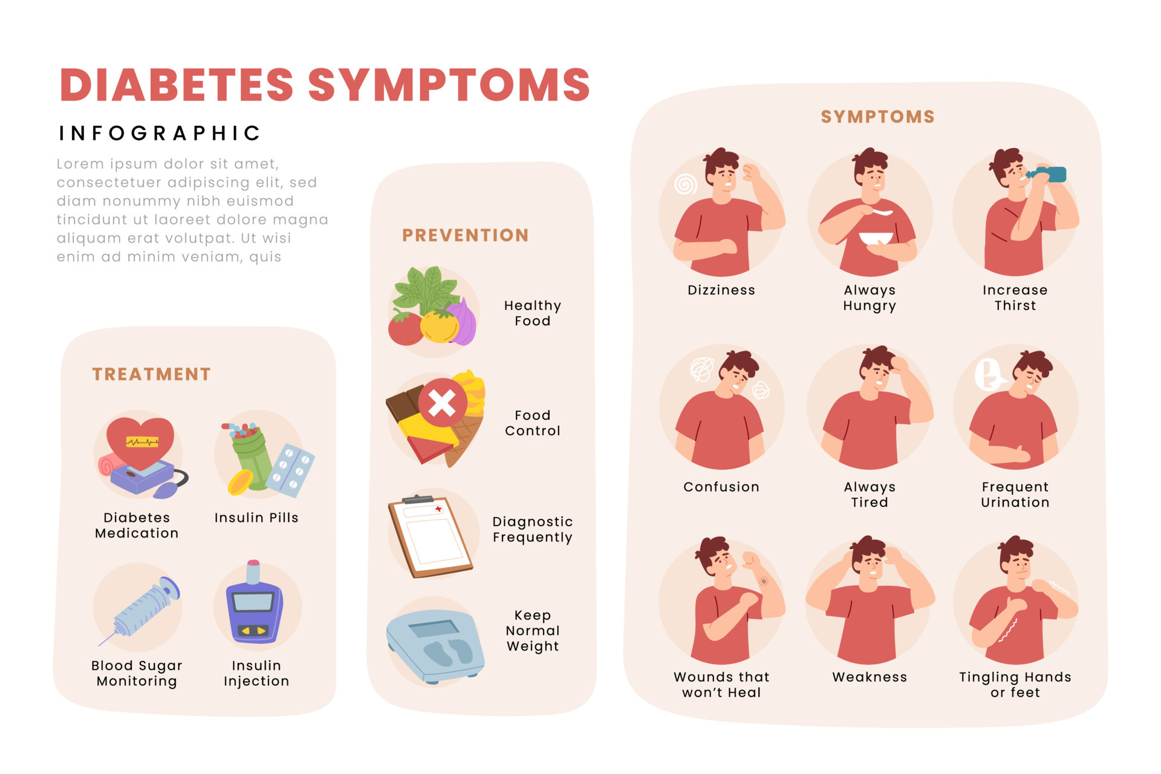

Slide 9
Prevention: Staying Healthy
Even if you don’t have Diabetes, it is important to:
Eat Healthy foods
Stay Active- play sports, ride a bike, go for a walk
Limit your sugary drinks and snacks
Get regular check ups
If you do have Diabetes:
Continue with staying healthy list
Monitor their blood sugars regularly
Take their medication as directed

Slide 10
Complications of Diabetes
Changes in circulatory system: Can cause Heart Attack, Stroke (brain attack), poor circulation to extremities, poor wound healing and kidney and nerve damage
Damage to the eyes and can cause vision loss and blindness
Poor circulation: Poor wound healing may cause leg and foot ulcers, infected wounds and may lead to amputation. Diabetic patients should wash their feet every day and wear clean socks. They should inspect their feet every day

Slide 11
What can make your blood sugar up swing
Illness- even when sick they need to take their insulin but maybe not full dose
Medications- Steroids and water pills, cold medicines like psuedophine
Stress or anxiety
Caffeine
Sugar free foods- usually are a lot of carbohydrates
High fat foods- can make your blood sugar stay high for longer- Pizza, French Fries, Chinese food
Sports Drinks- many have as much sugar as a soda
Dried fruit- Fresh fruit is a healthy choice but dried versions pack more carbohydrates in a smaller version

Slide 12
What can make your blood sugar down swing:
Household chores- cleaning the house, mowing the grass
Yogurt- best choice is plain or light yogurt without any extra sugar
Vegan Diet: all vegetable based High in fiber and whole grains
Exercise- need to be cautious here, monitor blood sugars frequently stay hydrated and have snacks available

Slide 13
What can we do for a diabetic reaction
Help them check their blood sugar if able
Have quick carbs ready: Grahm crackers, apple or orange juice, raisins or a candy bar. Glucose tablets or gel
Be ready to call 911 if necessary

Slide 14
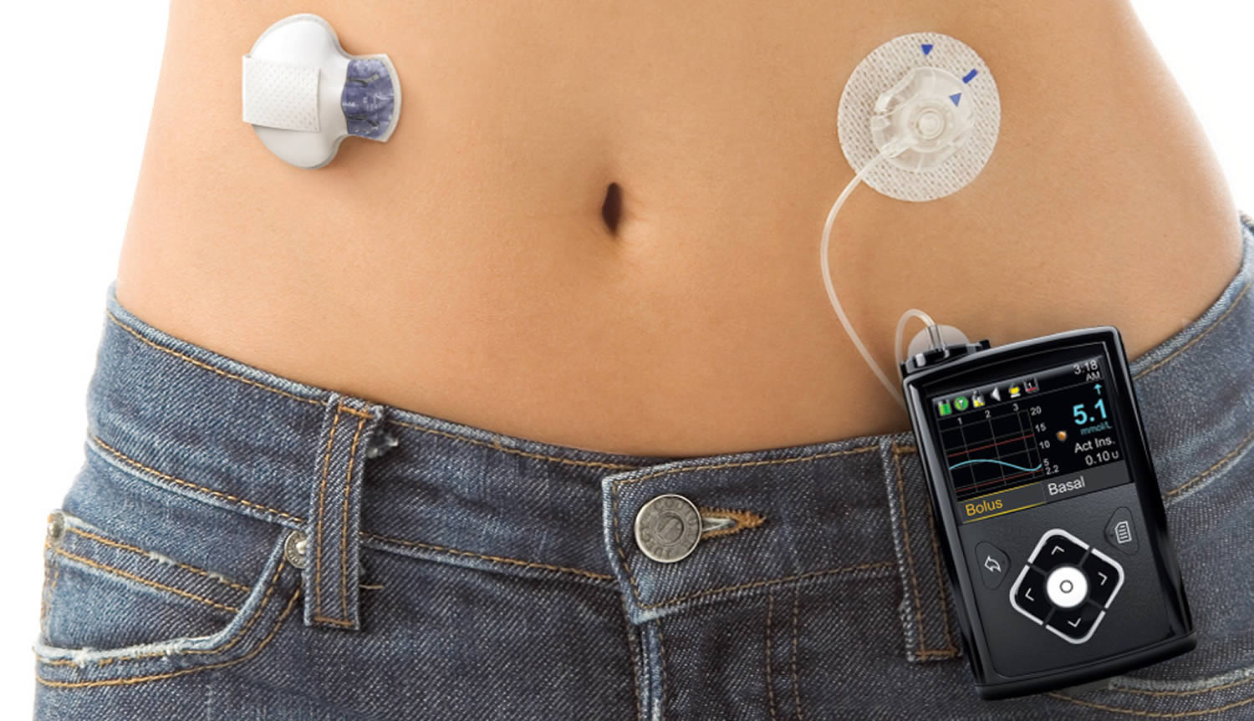

Slide 15
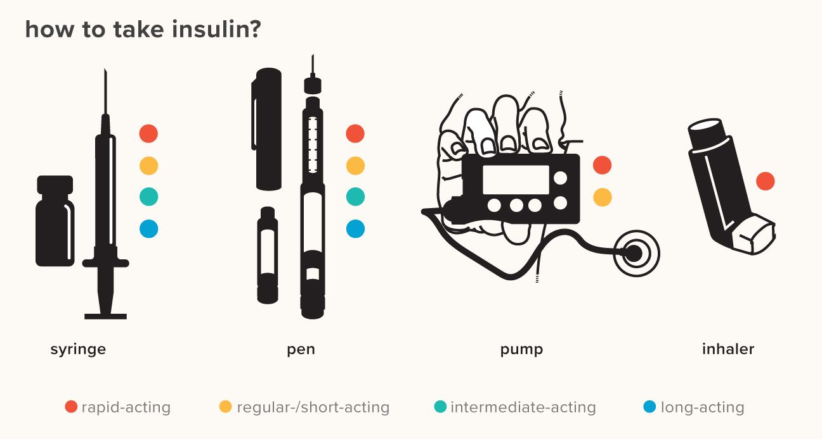

Slide 16
Endocrinologist- Doctor that prescribes the insulin
Every patient's amount of insulin is unique to only them. The endocrinologist will work with the patient and the nurses to find the best plan for each patient. This plan will include type and amount of insulin, diet and exercise to keep the patients blood sugar in a specific range for each patient.
A nondiabetic blood sugar is usually <100. We like to keep a diabetic between 70-110
Diabetic Educator will also work with the patient to meet their needs with the insulin, diet and exercise

Slide 17
Show video of Diabetic camp

