Slide 1
The Flipped ClassROOM
Beth McCaw. Most images through Pixabay

Slide 2
Using Time In and Out of Class in Fresh Ways to Increase Engagement and Learning

Slide 3
Question: Is a live lecture before a gathered class always the best way to provide lecture content?

Slide 4
A fresh perspective: Lecture (like reading) as preparation for class

Slide 5
Students can pause and take notes, helpful for ESL among other students

Slide 6
Video is available on the student’s clock, and can be individually paced and reviewed

Slide 7
Guest lecturers are easier to include

Slide 8
I valued the live lecture experience more than many of my students. For them, individual control over receiving the lecture content (viewing time, speed, repetition) trumped chemistry.

Slide 9
Question: Is formulating initial impressions of fresh content the best use of gathered class time?

Slide 10
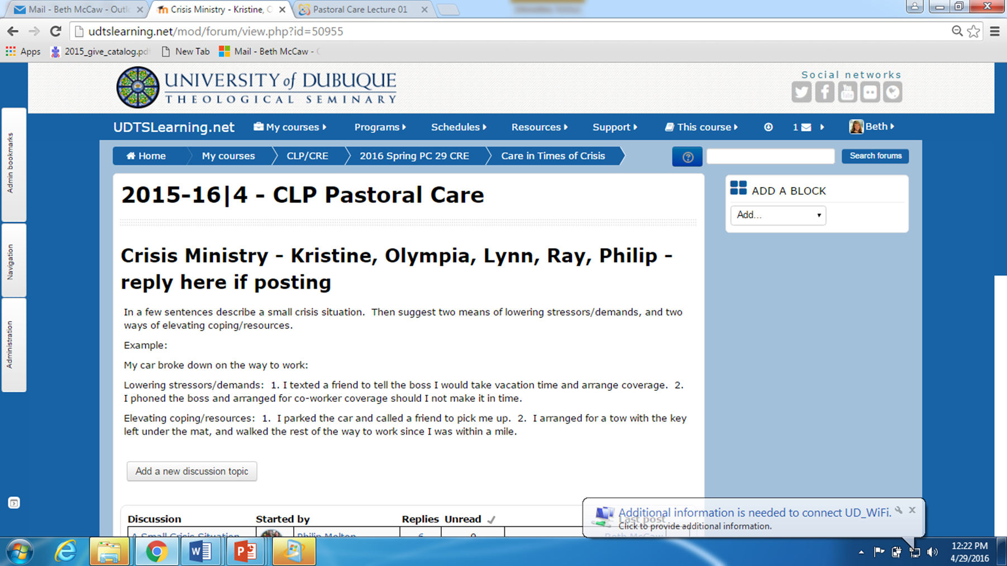
Fresh perspective: Assign comprehension and exploration of topic prior to class

Slide 11
Students gather with thoughtful questions and insights, having already been engaged with the content

Slide 12
Question: Is looking at faces while you lecture the most precise way to gauge comprehension?
“That is a brilliant thought!!” - or? –
“It is almost time for lunch!” – or? –
“She’s incoherent,
I’ll try to look encouraging.”

Slide 13
Fresh perspective: A deliberate check-in between lecture and discussion allows you to use class time more intelligently

Slide 14
Brief online posts, or 5-minute quizzes, have guided my use of class time to fine-tune comprehension
Example:
Half of one class confused
“reducing stressors…”
…with the popular notion of
“stress relief.”
I was able to catch and correct this in class discussion
- before we got to an exam, a paper, or the parish.

Slide 15
Question: Is practice and mastery best done on an individual basis beyond the classroom – “homework”?

Slide 16
Fresh perspective: A gathered class is used for engagement, practice, and feedback

Slide 17
Displacing the lecture allows time for class exercises, such as analyzing one couple’s communication style

Slide 18
Exercises like role playing provide opportunity for feedback, and cement learning

Slide 19
Having others with whom to engage in practices, like intercessory prayer, helps students establish their voices or find their stride

Slide 20
Some forms of creative thinking – such as brainstorming – often happen best in groups

Slide 21
A gathered class is ideal for student presentations, demonstrations, and Q&A

Slide 22
Classmates can provide valuable feedback for projects and presentations

