Slide 1
UD Worship: Praising God at work in theDominican Republic 2018
Notes:
----- Meeting Notes (6/19/18 10:42) -----
2nd year

Slide 2
We turn to God in praise
Tuya es la Gloria We sing of your glory
La honra tambien; we praise you again;
Tuya para siempre. For you are eternal.
Amen. Amen. Amen. Amen.
From Sing the Faith #2011, Traditional Latin American.

Slide 3
Tuyos los dominos We sing of your power
las tronos tambien; and honor again;
Tuyos para simepre. For you are eternal.
Amen. Amen. Amen. Amen.

Slide 4
A ti yo me rindo We sing of surrender
Te adoro, tambien; to you, God, again.
Amor absoluto. Your power is eternal.
Amen. Amen. Amen. Amen.

Slide 5
Gloria-en las alturas Glory in the highest
Y-en la tierra tambien on earth, sing again.
Gloria aleluya, Gloria, Alleluia,
Amen, amen. Amen, amen.

Slide 6
Prayer
One: Taste and see
the sweetness of diversity,
All: the richness of many cultures
in this one, unique, never uniform, world.
One: Taste and see
the bitterness of divisions,
All: the barrenness of our imaginations,
the false limitations
we put upon the world.

Slide 7
One: Taste and see
the goodness of creation,
All: the nourishment of God’s giving
in equal love for every child
in the world.
One: Taste and see
the evil of our denial,
All: the selfishness of failing to share
with brothers, sisters, resources of the world.

Slide 8
All: Creator God,
help us to taste and see
welcome and affirm,
celebrate and share –
in the name of Jesus
who came to redeem
the way we live in this world;
in the power of the Spirit,
who, in a world of difference,
makes us one.
Jan S. Pickard in Living Prayers for Today

Slide 9
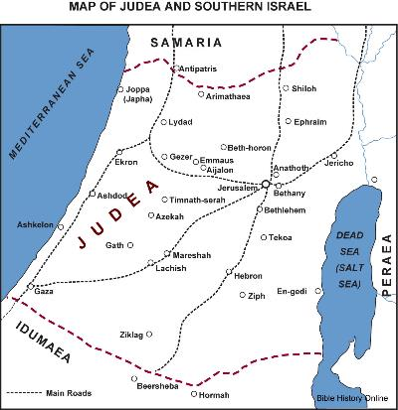
Acts 1:8
But you will receive power when the Holy Spirit has come upon you; and you will be my witnesses in Jerusalem, in all Judea and Samaria, and to the ends of the earth.

Slide 10
Our partnership in the Dominican Republic
Notes:
----- Meeting Notes (6/19/18 10:42) -----
Piedra Blanca
El Batey-Attempting to change name to Cristo Rey

Slide 11
The Foundation for Peace
A mission to work “Hand in Hand”
Providing Clean Water
Offering Medical Care through Teams
Education through Sponsoring Students
Worship
Partnerships with communities – such as UDTS and El Batey (Christo Rey – Christ the King)

Slide 12
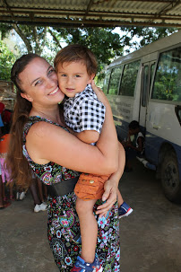
Kristin Hamner (and Nico) – field facilitator

Slide 13
El Batey – Christ the King - Village

Slide 14
El Batey is in the second year of being cut off from the highway by a collapsed bridge

Slide 15
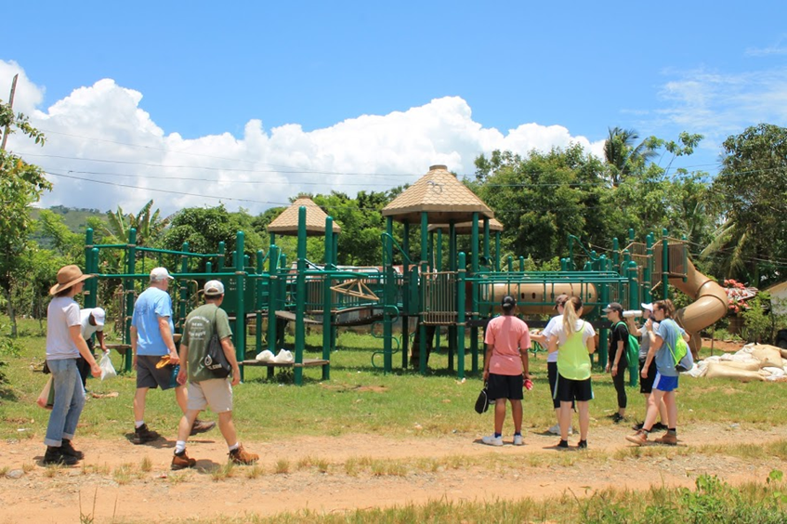
A Vision of a Town Center

Slide 16
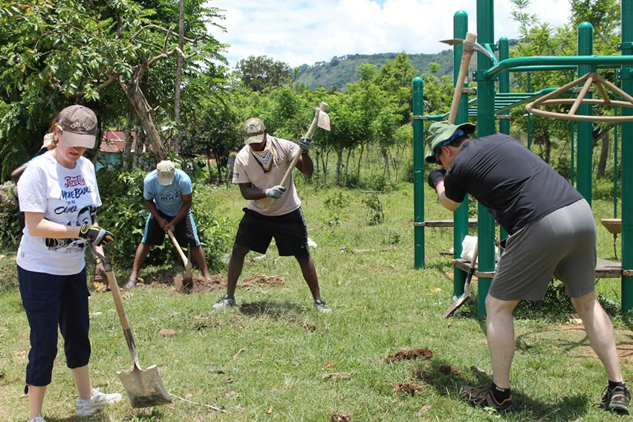
A playset grows into a safe park

Slide 17
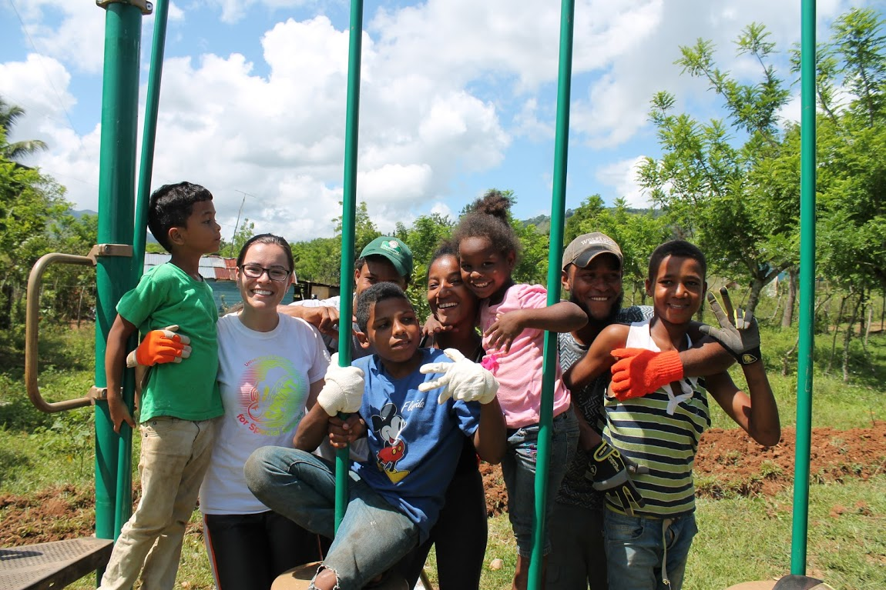

Slide 18
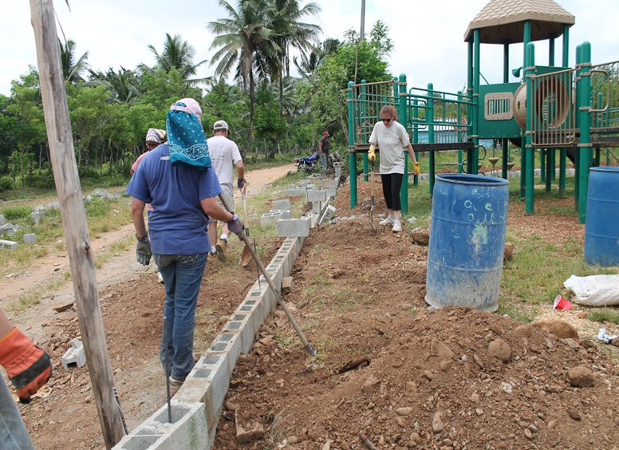

Slide 19
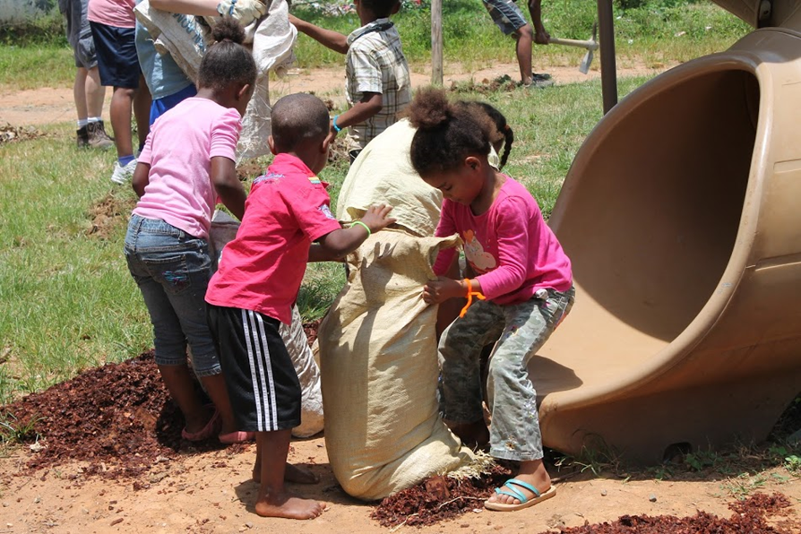
With much mulching…

Slide 20
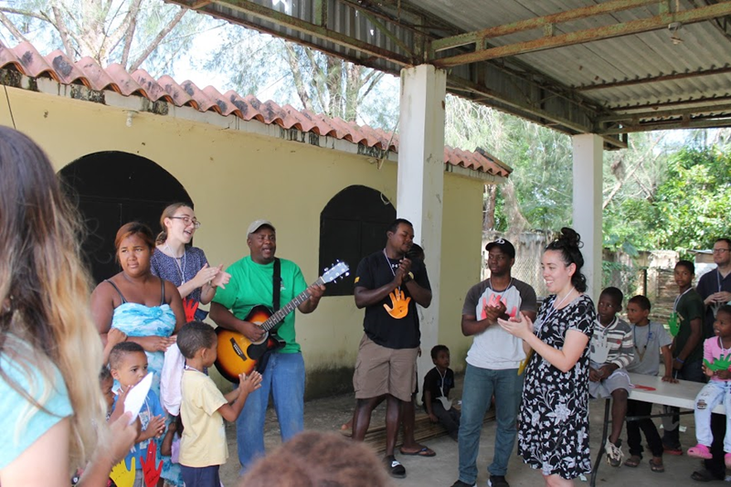
Returning to share worship, VBS with the El Batey Church

Slide 21
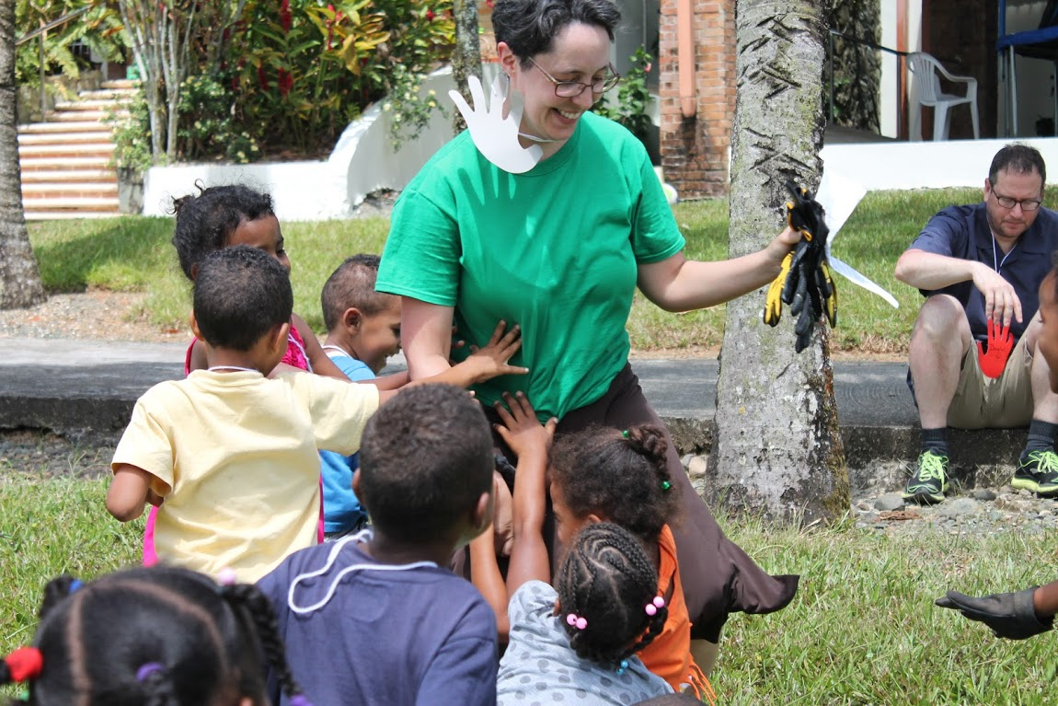

Slide 22
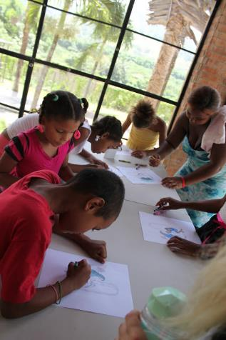
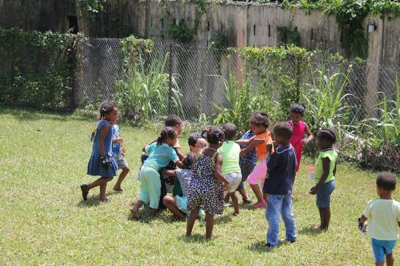

Slide 23
Shared Worship Services

Slide 24
A combined witness on the worksite and in worship…
Pastor Katia and El Batey Church
Kristin Hamner and Foundation for Peace Staff
Pastor Alejandro from San Joaquin
University of Dubuque
Morristown Presbyterian Church
- Unity
- Remembrance
- And Shared Praise of God

Slide 25
Scripture: John 17:20-23
²⁰ “I ask not only on behalf of these, but also on behalf of those who will believe in me through their word, ²¹ that they may all be one. As you, Father, are in me and I am in you, may they also be in us, so that the world may believe that you have sent me. ²² The glory that you have given me I have given them, so that they may be one, as we are one, ²³ I in them and you in me, that they may become completely one, so that the world may know that you have sent me and have loved them even as you have loved me.

Slide 26
Testimonies
Krista Denne –
The Unfolding Kingdom Work
Melinda Stonebraker –
Presence and Communion

Slide 27
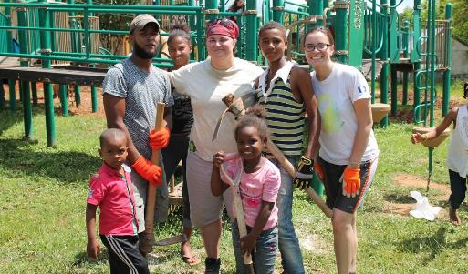
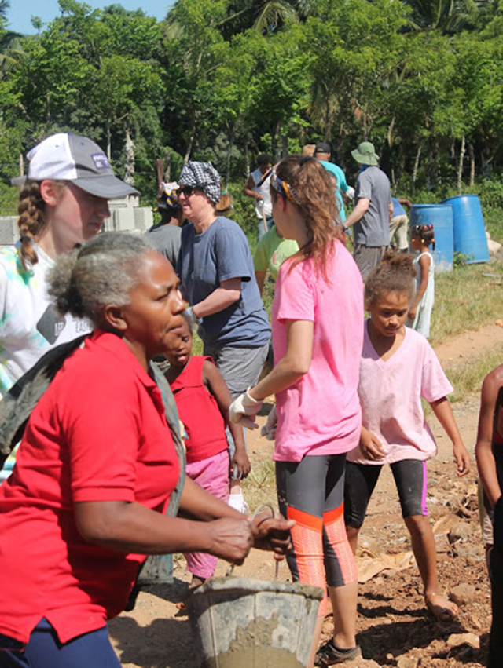

Slide 28
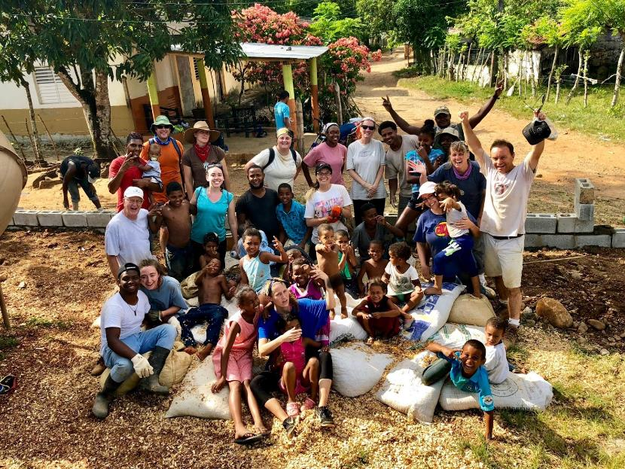

Slide 29
Offering: Sharing What We Have
Through Jesus, therefore, let us continually offer to God a sacrifice of praise—the fruit of lips that openly profess his name. And do not forget to do good and to share with others, for with such sacrifices God is pleased.
(Hebrews 13:15-16)

Slide 30
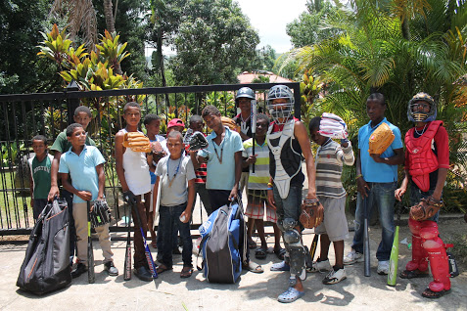
Delivery of Baseball Equipment

Slide 31
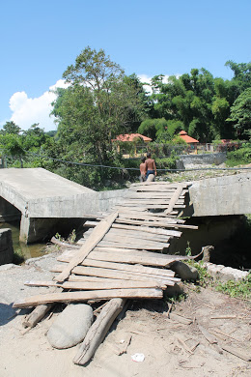
“Please – pray; the most critical help we need is a bridge.”

Slide 32
A Return Visit
May 29 – June 7 2019
Led by the PCUSA Synod of the Sun
with UDTS
Please drop your name in the offering plate if you would like information about being sent or helping to prepare and support.
Funds received will go toward the bridge restoration.

Slide 33
An Offering of Praise
Tu fidelidad es grande,
Tu fidelidad incomparable es.
Nadie como Tú bendito Dios,
Grande es Tu fidelidad.
CCLI Song # 2307105Miguel Cassina© 1990 Balsamo Producciones CCLI License # 922163

Slide 34
Sent with a Witness of Unity
We Are One In Christ Jesus
Somos uno en Cristo, somos uno,
Somos uno, uno solo.
Somos uno en Cristo, somos uno,
Somos uno, uno solo.
We are one in Christ Jesus
All one body all one spirit
All together
We are one in Christ Jesus
All one body all one spirit
All together

Slide 35
Un solo Dios, un solo Senor,
Una sola fe, un solo amor,
Un solo bautismo, un solo Espiritu,
Y ese es El Consolador!
We share one God, one mighty Lord,
One abiding faith, one binding love,
One single baptism, one Holy Comforter,
The Holy Spirit uniting all!

Slide 36
Somos uno en Cristo, somos uno,
Somos uno, uno solo.
Somos uno en Cristo, somos uno,
Somos uno, uno solo.
We are one in Christ Jesus
All one body all one spirit
All together
We are one in Christ Jesus
All one body all one spirit
All together

Slide 37
Un solo Dios, un solo Senor,
Una sola fe, un solo amor,
Un solo bautismo, un solo Espiritu,
Y ese es El Consolador!
We share one God, one mighty Lord,
One abiding faith, one binding love,
One single baptism, one Holy Comforter,
The Holy Spirit uniting all!
CCLI Song # 6368975 Alice Parker © 1996 Abingdon Press

Slide 38
As we go out: Charge and Blessing

